Slide 1

Drama At Cornwallis Academy
Year 8 – Lesson 5
Lesson Objective:
-To continue to demonstrate an understanding of how show and develop a character
To devise a Murder Mystery play.
Success Criteria:
Performing and Creating
Level 3
I can sustain a role that I have created for some of the performance. I am more comfortable being led by others in a group situation.
Level 4
I can stay in role for good parts of my performance, occasionally struggling to keep focused. I will make a reasonable contribution to my groups work, sharing some simple ideas.
Level 5
I can stay in role for most of the performance with few distractions. I will make a positive contribution to a group, sharing ideas and showing some leadership.
Level 6
I can consistently stay in role for the whole of the performance. I Contribute ideas very well to the group I’m in and am capable of showing good leadership skills

Slide 2
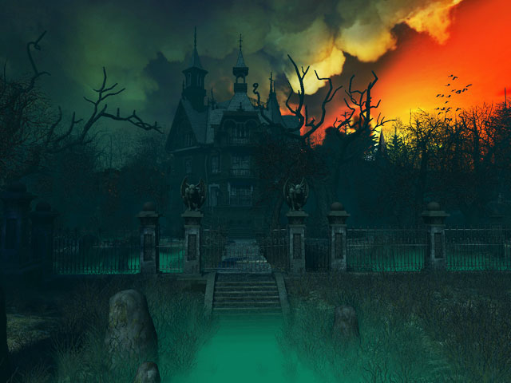
Lesson Objective:
-To continue to demonstrate an understanding of how show and develop a character
- To devise a Murder Mystery play.
Activity 1 – Murder Mystery game 5 – Who is the murderer?
WILF:
Creating and Performing
Level 3
I can sustain a role that I have created for some of the performance. I am more comfortable being led by others in a group situation.
Level 4
I can stay in role for good parts of my performance, occasionally struggling to keep focused. I will make a reasonable contribution to my groups work, sharing some simple ideas.
Level 5
I can stay in role for most of the performance with few distractions. I will make a positive contribution to a group, sharing ideas and showing some leadership.
Level 6
I can consistently stay in role for the whole of the performance. I Contribute ideas very well to the group I’m in and am capable of showing good leadership skills

Slide 3
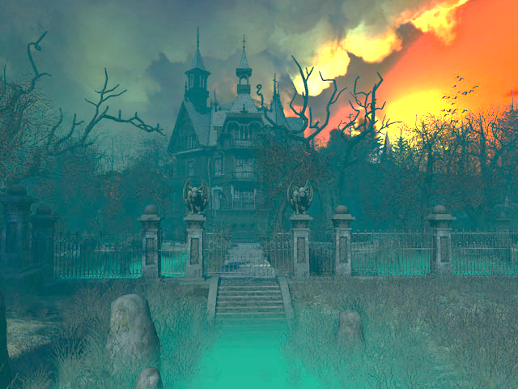
Lesson Objective:
-To continue to demonstrate an understanding of how show and develop a character
- To devise a Murder Mystery play
WARM-UP – Cut the cake
What skills are you having to use?
Why are these important in drama and the world of work.
Success Criteria :
Creating and Performing
Level 3
I can sustain a role that I have created for some of the performance. I am more comfortable being led by others in a group situation.
Level 4
I can stay in role for good parts of my performance, occasionally struggling to keep focused. I will make a reasonable contribution to my groups work, sharing some simple ideas.
Level 5
I can stay in role for most of the performance with few distractions. I will make a positive contribution to a group, sharing ideas and showing some leadership.
Level 6
I can consistently stay in role for the whole of the performance. I Contribute ideas very well to the group I’m in and am capable of showing good leadership skills
Notes:
Students stand in a circle.
One person stands in the middle.
They all chant cut the cake.
The person in the middle cuts the circle by placing one arm between two people. Those students turn away from the cutting arm and run around the outside of the circle in opposite directions. The cake cutting stands in their spaces holding up their hands. The person on the outside to reach the hand of the cutter first wins and the other person goes into the middle.

Slide 4
Murder Mystery Assessment
I will now give you back your planning sheets and give you 3 minutes to look over the decisions you have made about your Murder Mystery.

Slide 5

Task 1 – Rehearsal time
You will now have 15 minutes to act our your Murder Mystery's. You will need to ensure that it includes the following things:
A Murder
Suspects
Victim
Murderer
Detective
You must not show the Murder as we will need to guess who did it.
Murder Mystery Assessment

Slide 6
Task 2 – Performance 1 You will now perform you pieces to the rest of the class and receive feedback. The rest of the class with need to give positive criticism looking at what you did well and what needs to be improved. We will also be looking to ensure you have included the suggested things.
A Murder
Suspects
Victim
Murderer
Detective
You must not show the Murder as we will need to guess who did it.
Murder Mystery Assessment

Slide 7
Questions and Answers
What do you need for next lesson?
What you need to think about in order to be fully prepared?
What level are you on and why?
Murder Mystery Assessment

